Slide 1



St Andrew’s
Christmas
Cracker
With Children of the School Choir
&
Orford Community Singers

Slide 2

In the Bleak Mid-Winter
Orford Community Singers

Slide 3
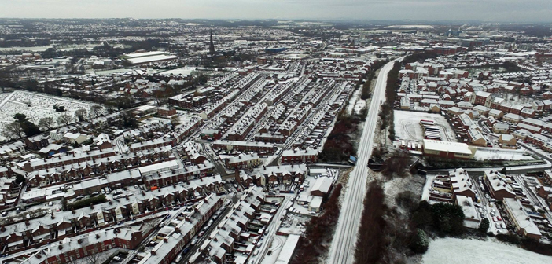
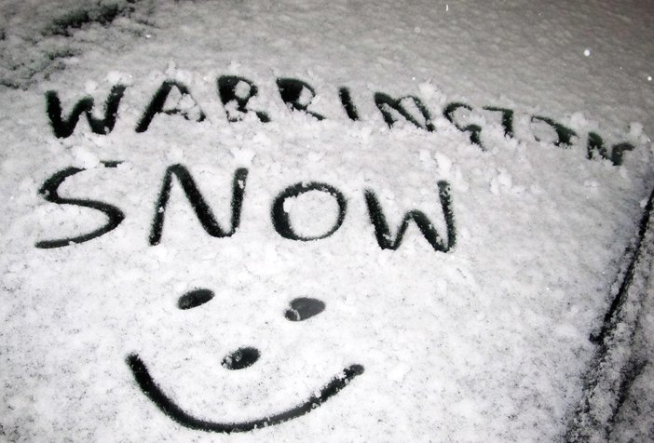
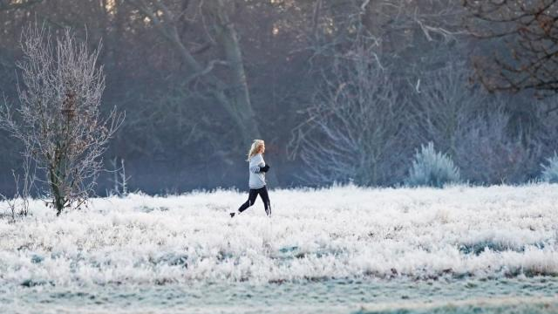
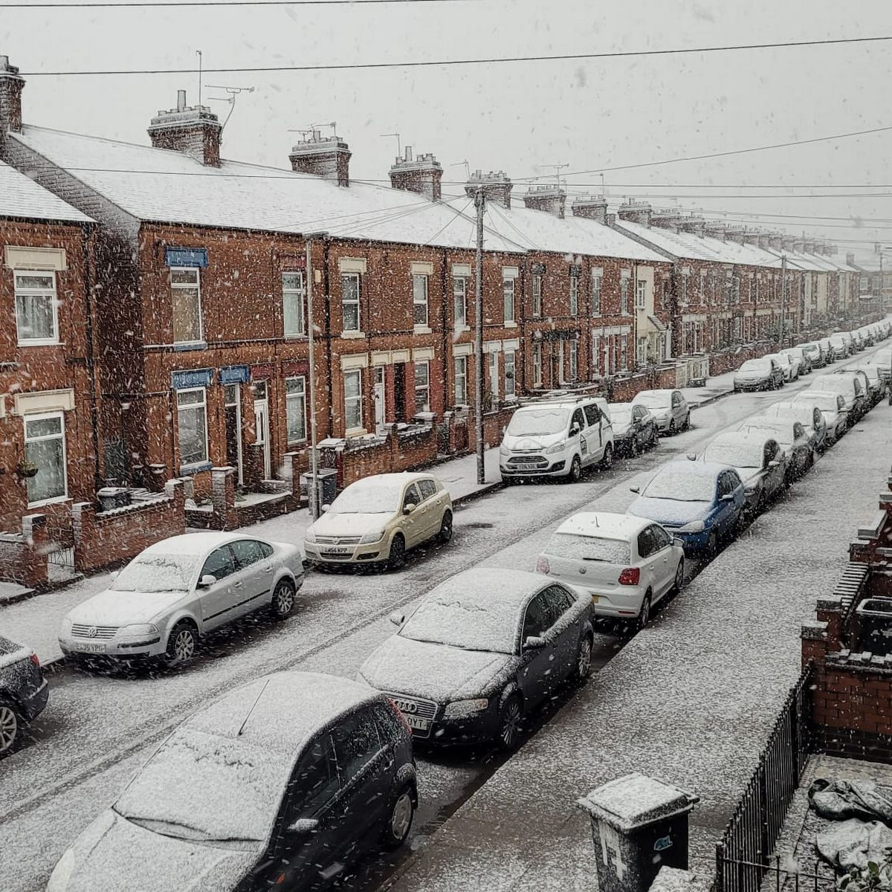

Slide 4
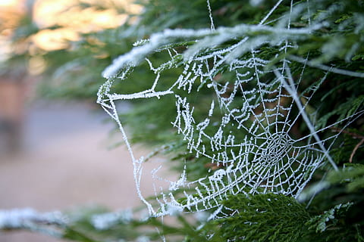
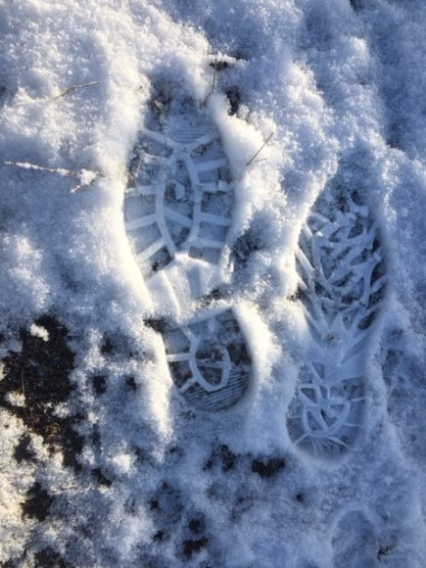
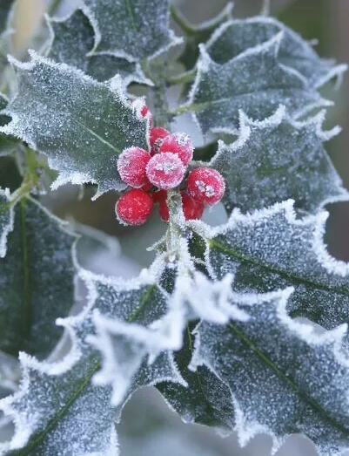


Slide 5
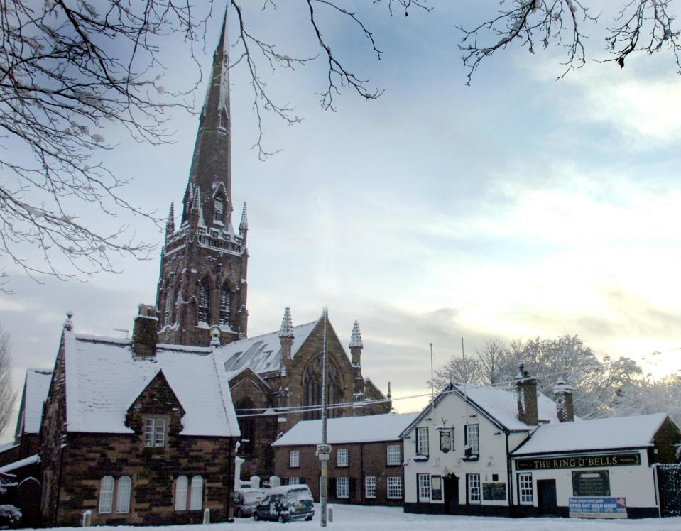
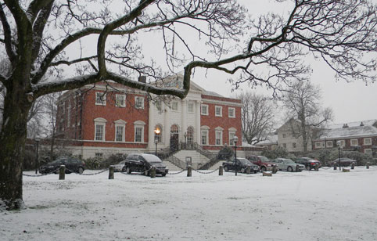
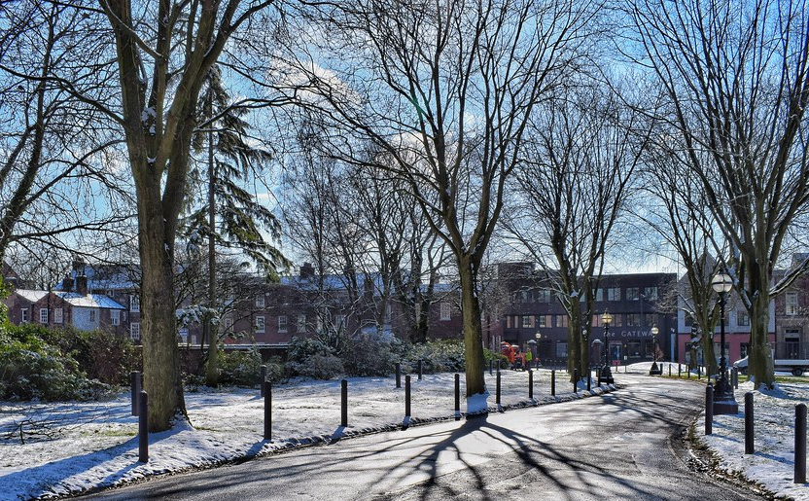


Slide 6
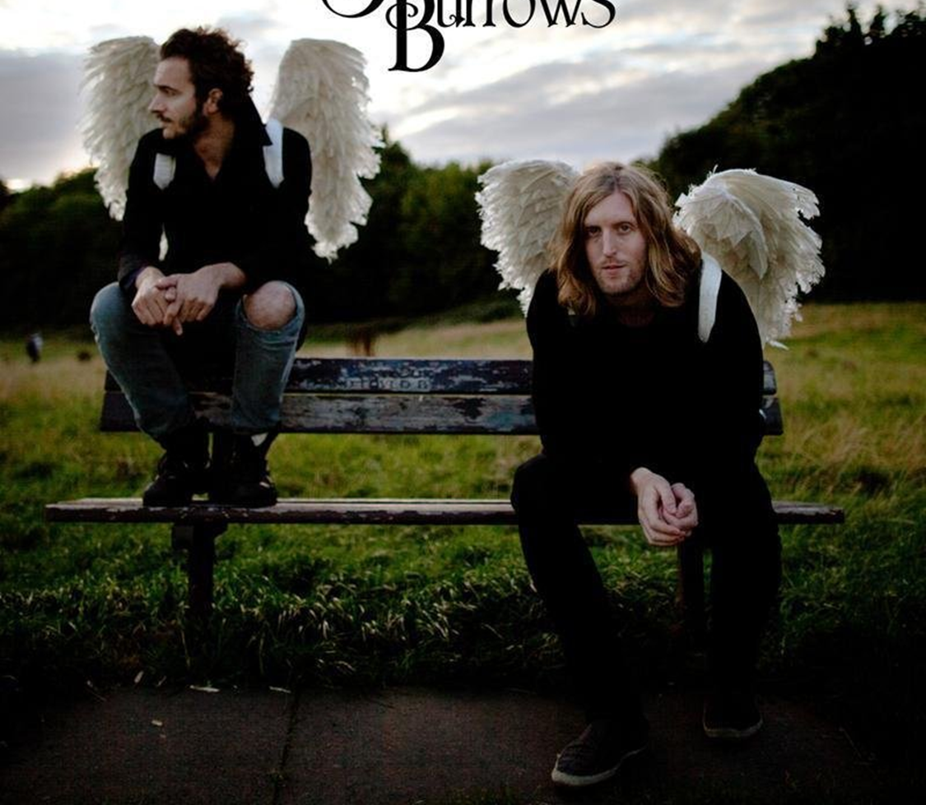
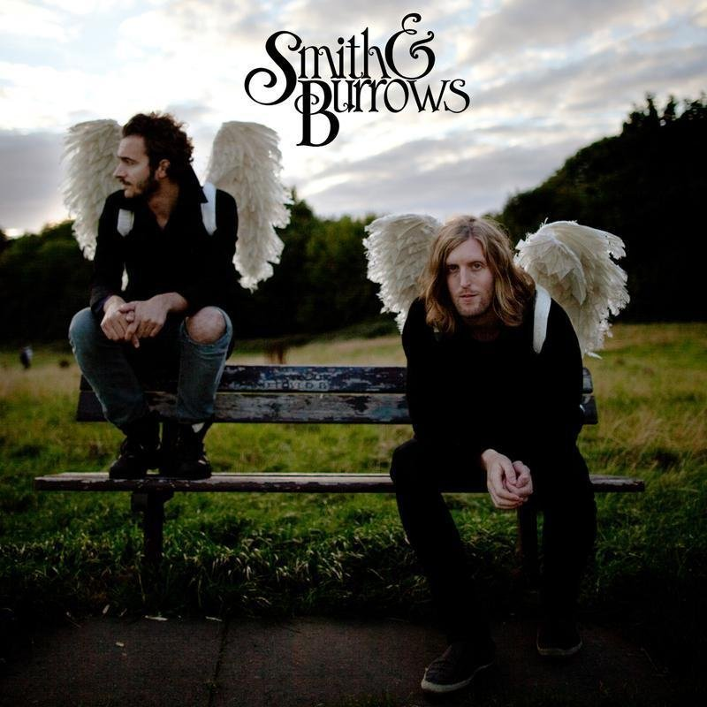


Slide 7
Luke 1:26-33
Read by Peter Naylor

Slide 8
We sing together…..
O Little Town of Bethlehem
Carol #1

Slide 9
Carol of Mary
Orford Community Singers

Slide 10
Luke 2:1-7
Read by Rev Pip Shaw

Slide 11
We sing together…..
While Shepherd Watched…
Carol # 7

Slide 12
Tonight
Orford Community Singers

Slide 13
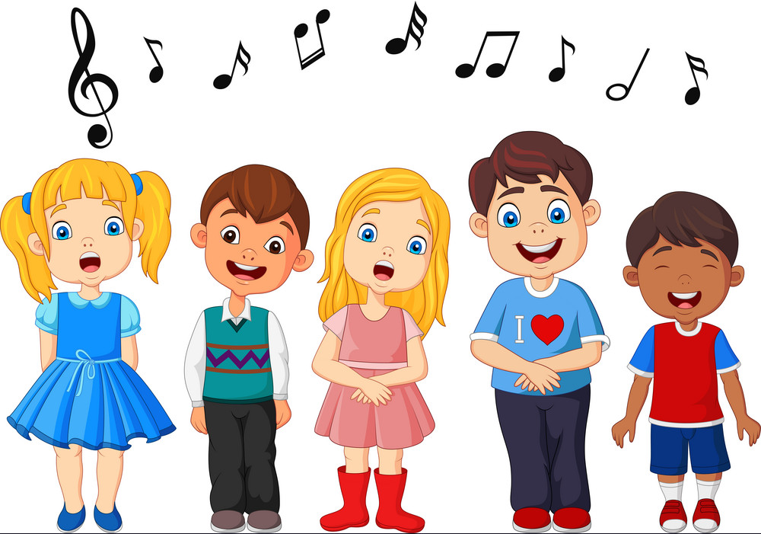
The Children Sing…..
If I Were There
St Andrew’s School Choir

Slide 14
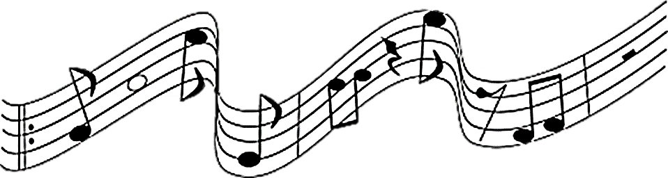
If I Were There

Slide 15
We sing together…..
Away in a Manger
Carol #6
Children sing First Verse

Slide 16
One Solitary Life
Read by Mara Livingstone

Slide 17
If Ye Would hear the Angels Sing
Orford Community Singers

Slide 18
We sing together…..
Ding Dong Merrily on High
Carol # 17

Slide 19
The Children Sing…..
When we Seek Him
St Andrew’s School Choir

Slide 20
When we Seek Him

Slide 21
Star Carol
Orford Community Singers

Slide 22
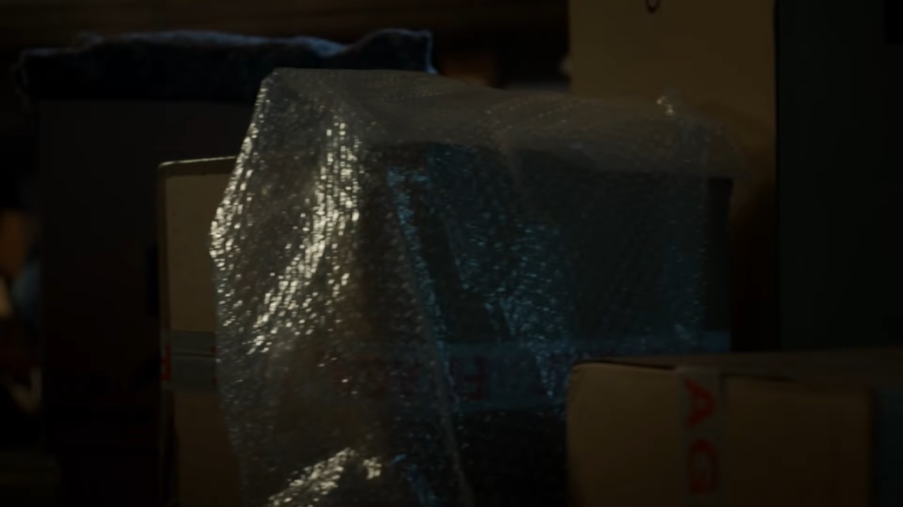

Slide 23
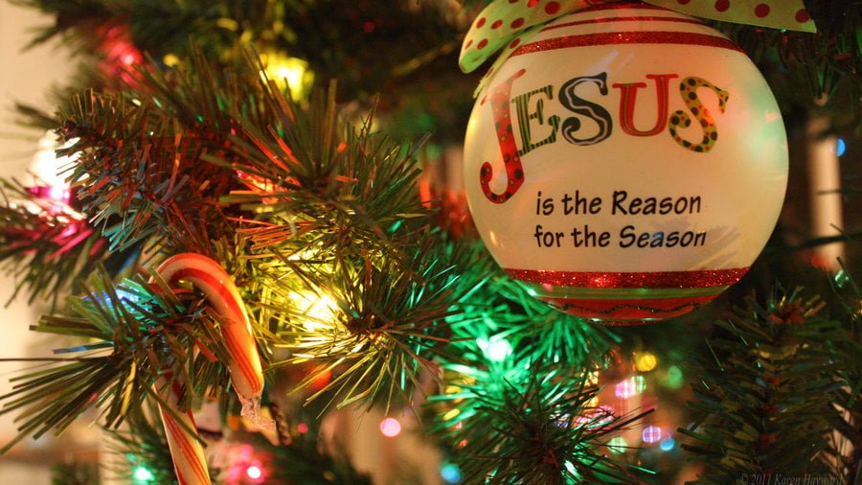

Slide 24
Enfleshed -God Around Us
Read by Rev Gill Hitchen

Slide 25
Star Carol
Orford Community Singers

Slide 26
We sing together…..
Angels from the realms of Glory
Carol # 18

Slide 27
Glad Tidings of Comfort & Joy
Orford Community Singers

Slide 28

Prayer of Blessing

Slide 29
We sing together…..
Hark the Herald Angels Sing!
Carol #10

Slide 30
St Andrew’s
Christmas
Cracker

